Slide 1
LABOUR Management System
WWW.LABMAN.XYZ
Farmers Digital ledger…..

Slide 2

Labours Management System
Submitted By
Jadav Anil Vijaybhai()
Rajyaguru Harsh Vijaybhai()
Guidded by Vipul Sopariya
Smt. K.B. Parekh College of Computer Science -Mahuva
(Affiliated to Maharaja Krishnakumarsinhji Bhavnagar University)

Slide 3
Introduction of labour management system
As per wikipedia India ranks second worldwide in farm outputs. As per 2018, agriculture employed more than 50% of the Indian work force and contributed 17–18% to country's GDP.
All industries adopt information technology for digitization but agriculture industry is not grown in past.
we found an opportunity to digitize the agriculture and make farmer life easy using software.

Slide 4

INTRODUCTION
LABMAN is a online farm ledger tool that helps farmer to manage the labours payment , working days , transaction and Analytics.
www.labman.xyz

Slide 5
Problem & Solution
we found an opportunity to digitize the agriculture and make farmer life easy using software.
As we know in labours work in farms to produce Crops and farmer pay for they work.
farmer make a ledger (book of labours work) to make their payment and track records
We found solution for the old traditional ledger book to the online ledger that helps to manage labours payments , working days , labours tracks and more…
we developed a Web Application to solve this problem and consider as our final year project.

Slide 6
Top Features in our system (modules)
1
2
3
4
Add Labours
Create List (ledger page)
Farmer add labours in sys only one time.
Farmer create list by providing some basic information.
Payment and transactions
ANALYSIS & Summary Report
Farmer pay labours and maintain their payment tracks .
Farmer easily get analytics of list or labours like his working days, payment and more..

Slide 7
Project Planning & Scheduling
1

Slide 8
Project Title
Template used
Live Website
Labman
Purple Admin
www.labman.xyz
Labour Management System
From bostrapdash.com for free
Live website using web hosting
Front End tools
Back End tools
Html , Css
PHP , My Sql
Hyper text markup language
Cascading Style Sheet
Hypertext Preprocessor(php)
Structured Query Language(mysql)

Slide 9
SCHEDULE
ANALYSIS
DESIGN AND MODIFICATION
Coding
Final Testing
1 week
1 December
To
7 December
2 weeks
8 December
To
31 December
5 weeks
1 January
To
7 February
1 Week
8 February
To
15 February

Slide 10
HARDWARE SOFTWARE REQUIREMENT
HARDWARE
SOFTWARE
Min 1GB RAM
Min 50mb to 100mb STORAGE
ANY I3 PROCESSOR
PHP 7.0
MYSQL
TEXT EDITOR
XAMPP
BROWSER
MS OFFICE

Slide 11
SYSTEM DESIGN
2
Data dictionary
Dfd
E r diagram
Usecase diagram
Input output designs

Slide 12
USER TABLE
(user table store user basic information its used to login and registration)
COLUMN NAME | DATA TYPE | SIZE | CONSTRAINTS
ID | INT | 11 | PRIMARY KEY(AI)
PHONE | VARCHAR | 10 | UNIQUE
PASSWORD | VARCHAR | 50 | NOT NULL
NAME | VARCHAR | 30 | NOT NULL
TYPE | VARCHAR | 1 | NOT NULL
IMG | VARCHAR | 50 | NULL
ADDRESS | VARCHAR | 50 | NOT NULL
REG_DATE | DATE | - | NOT NULL
LAST_LOGIN | DATE | - | NOT NULL
DBNAME | VARCHAR | 12 | UNIQUE

Slide 13
LABOURS TABLE
(labour table store labours basic information its used to get labours in list)
COLUMN NAME | DATA TYPE | SIZE | CONSTRAINTS
LID | INT | 11 | PRIMARY KEY(AI)
UID | INT | 11 | FOREIGN KEY
USERDB | VARCHAR | 12 | FOREIGN KEY
NAME | VARCHAR | 20 | NOT NULL
ADDRESS | VARCHAR | 30 | NOT NULL
LOCATION | VARCHAR | 20 | NOT NULL
NUMBER | VARCHAR | 12 | NOT NULL
GENDER | VARCHAR | 6 | NOT NULL
RDATE | DATE | - | NOT NULL

Slide 14
DYNAMIC TABLE
(after registration dynamic table is created this table is used to create list)
COLUMN NAME | DATA TYPE | SIZE | CONSTRAINTS
Id | INT | 11 | PRIMARY KEY(AI)
LISTID | INT | 11 | UNIQUE
LID | INT | 11 | FOREIGN KEY
LISTNAME | VARCHAR | 10 | NOT NULL
NAME | VARCHAR | 30 | NOT NULL
LOCATION | VARCHAR | 20 | NOT NULL
WORK | VARCHAR | 20 | NOT NULL
COUNT | INT | 5 | NOT NULL
AMT | FLOAT | - | NOT NULL
STATUS | VARCHAR | 11 | NOT NULL
PDATE | DATE | - | NULL
LDATE | DATE | - | NOT NULL
BENEFITS
Speed access
Separate tables
Quick operations

Slide 15
TRANSACTIONS TABLE
(it’s used store the transactions of payments)
COLUMN NAME | DATA TYPE | SIZE | CONSTRAINTS
TID | INT | 11 | PRIMARY KEY(AI)
DBNAME | VARCHAR | 12 | FOREIGN KEY
LID | INT | 11 | FOREIGN KEY
LISTNAME | VARCHAR | 10 | NOT NULL
LISTID | INT | 11 | FOREIGN KEY
LNAME | VARCHAR | 20 | NOT NULL
AMT | FOLAT | - | NOT NULL
RID | INT | 11 | FOREIGN KEY
TDATE | DATE | - | NOT NULL

Slide 16
MSG TABLE
(store the messages of user its used to send and receive messages)
COLUMN NAME | DATA TYPE | SIZE | CONSTRAINTS
ID | INT | 11 | PRIMARY KEY(AI)
RECIVER | VARCHAR | 12 | FOREIGN KEY
MSG | VARCHAR | 150 | NOT NULL
TITLE | TEXT | - | NOT NULL
SENDER | VARCHAR | 12 | FOREIGN KEY
STATUS | VARCHAR | 6 | NOT NULL
DATE | DATE | - | NOT NULL

Slide 17
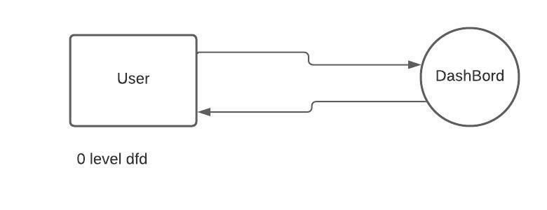
Data Flow Diagrams
Request
Response

Slide 18
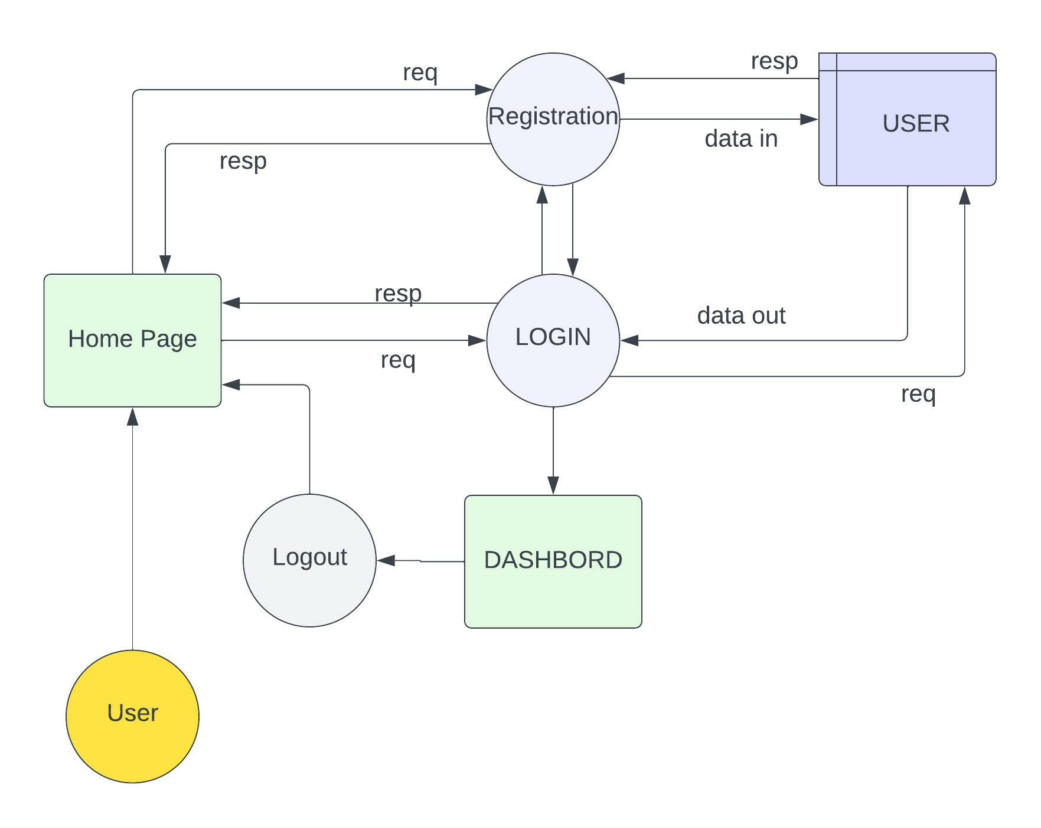
Data Flow Diagrams
1st Level DFD

Slide 19
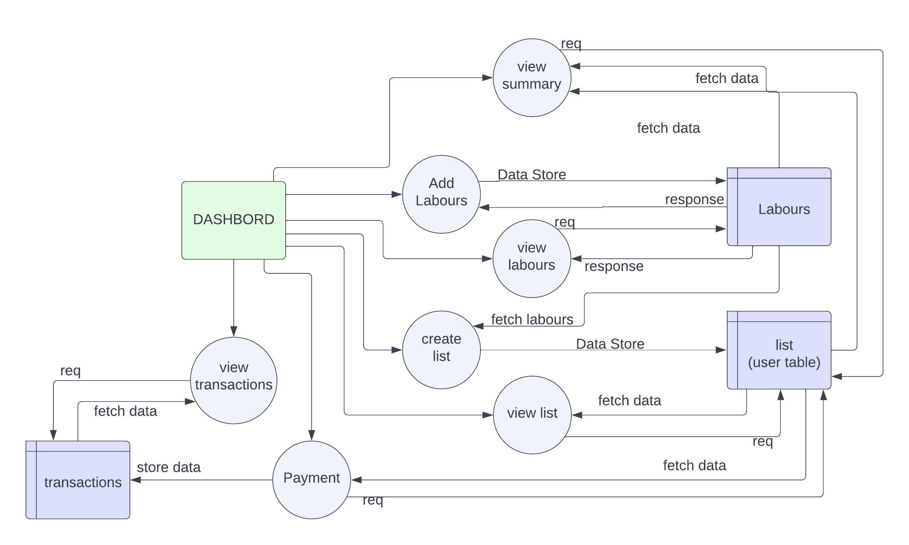
Data Flow Diagrams
2nd Level DFD

Slide 20
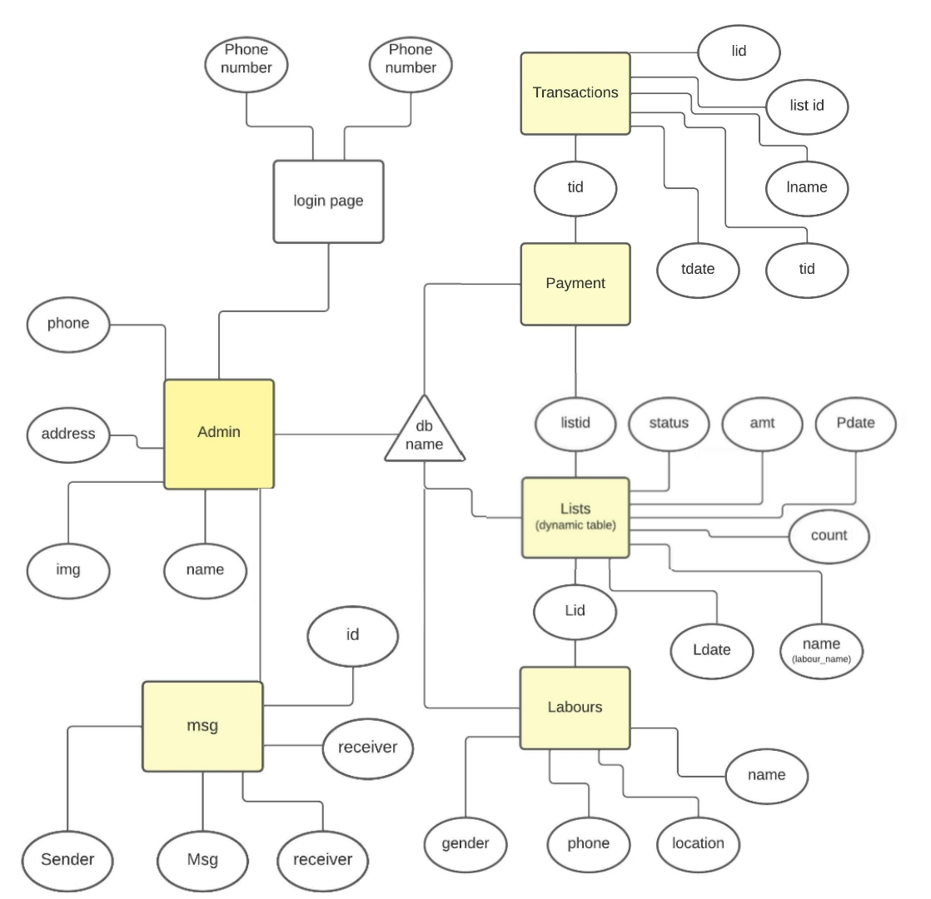
ER Diagram

Slide 21
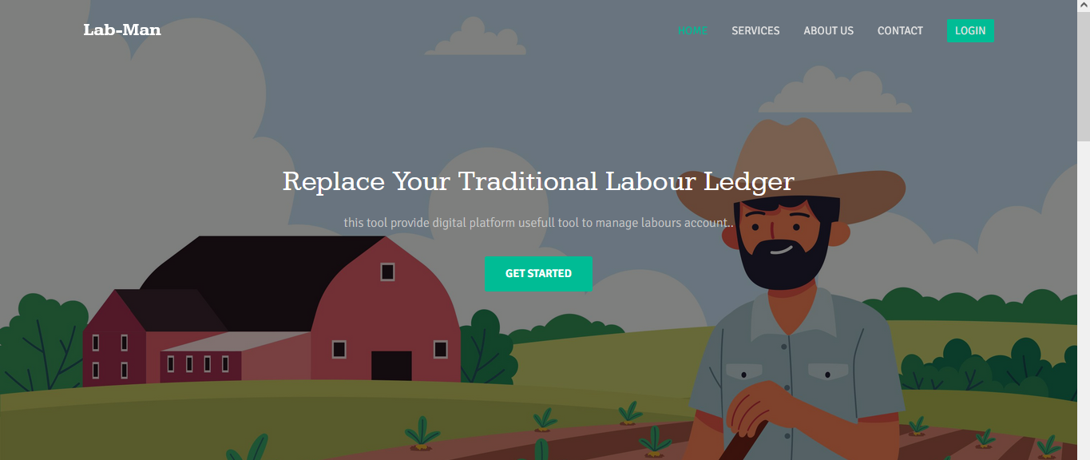
HOME PAGE
Landing Page for a website

Slide 22
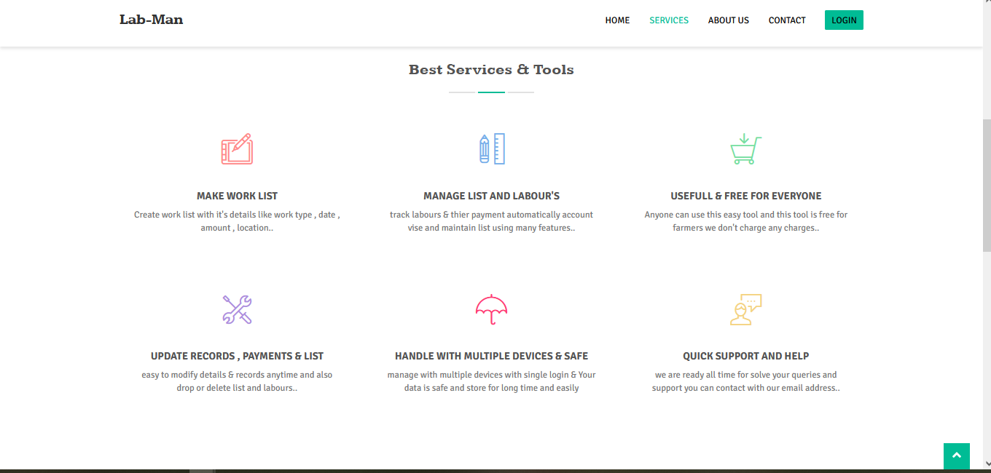
HOME PAGE
Landing Page for a website

Slide 23
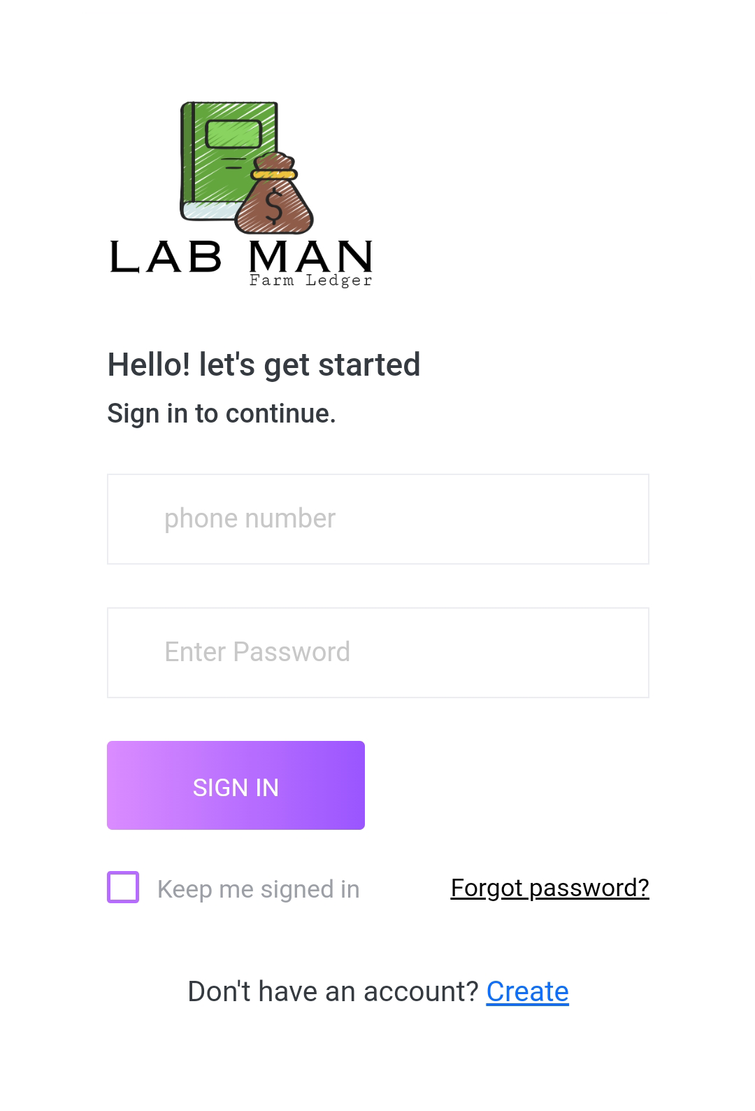
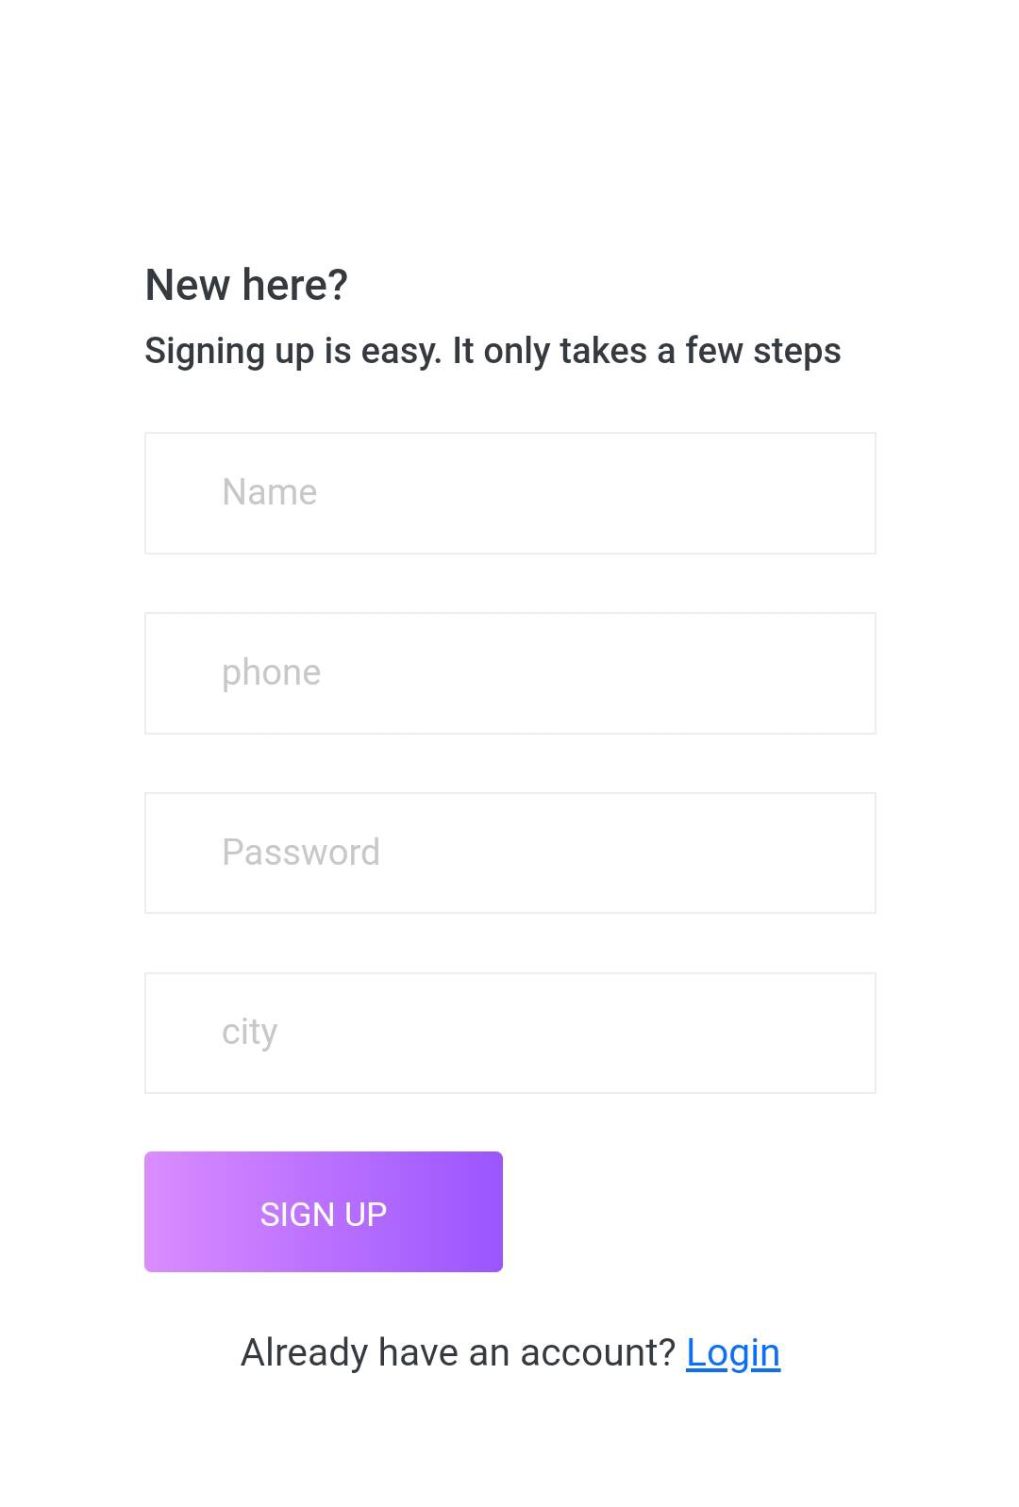
LOGIN PAGE
REGISTRATION PAGE

Slide 24
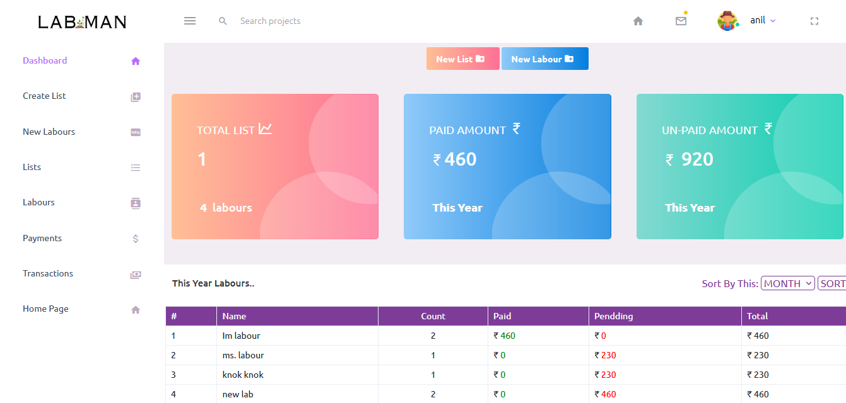
DASHBORD
2

Slide 25
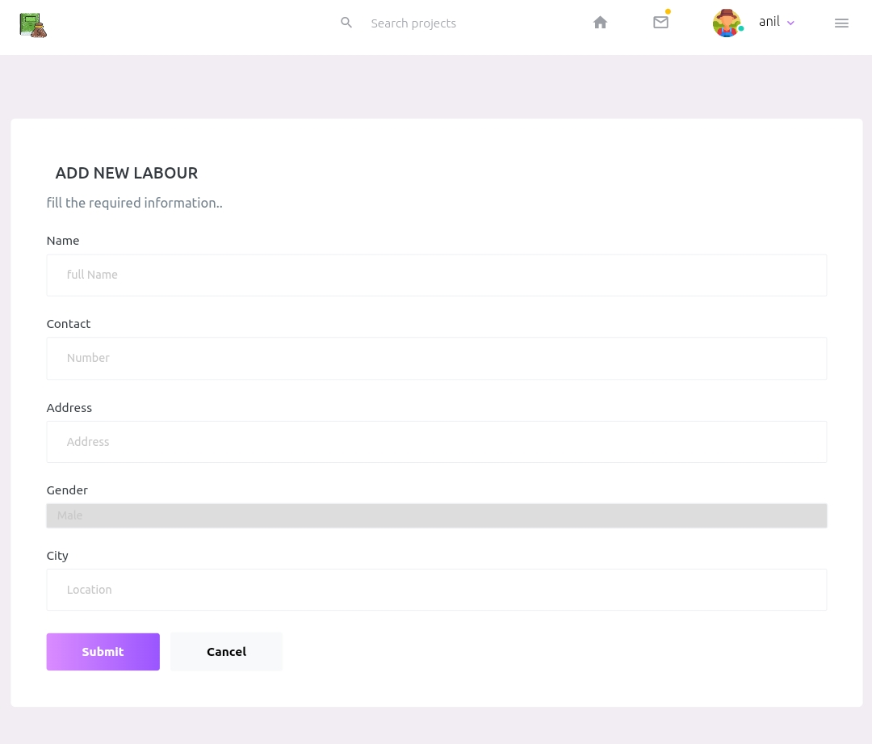
Add Labours Page
Provide basic info to
Add new labours in
System.

Slide 26
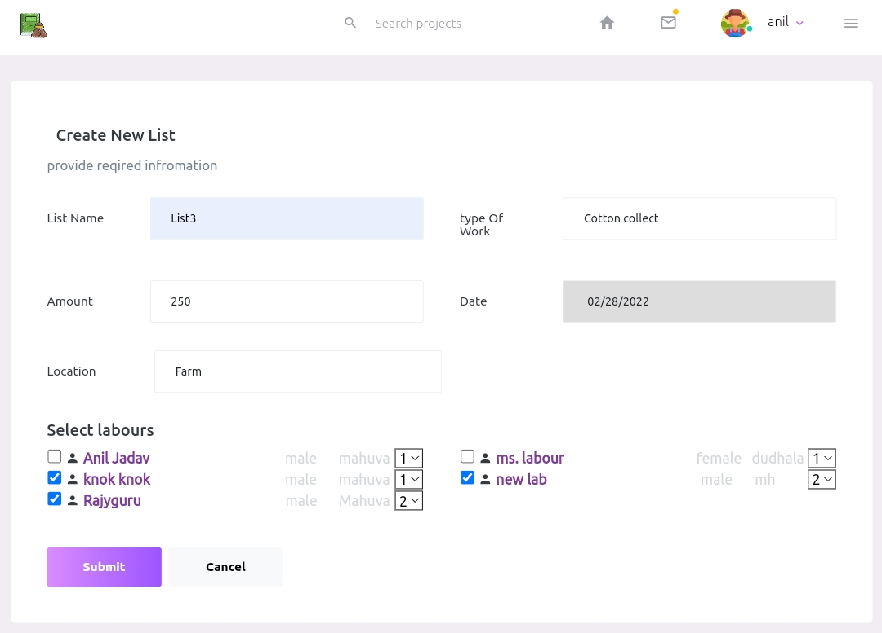
Create List Page
Make a list by selecting
Labours and by filling
required Information.

Slide 27
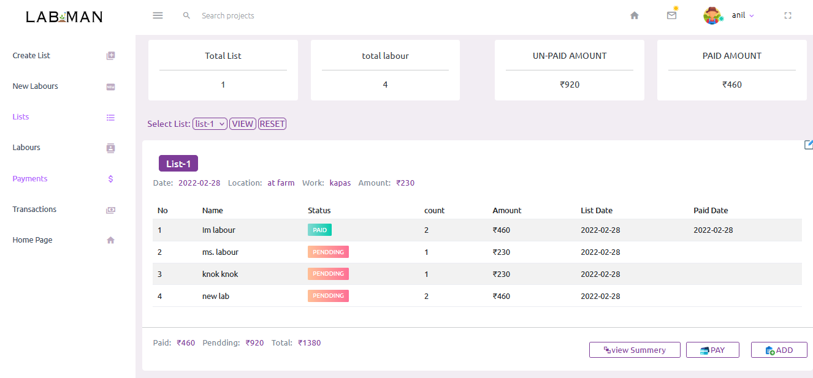
View List Page
View list
Edit List
Delete List
Add List
Payment
View Summary
Add Labours
Remove Labours
Provide basic info to
Add new labours in
System.

Slide 28
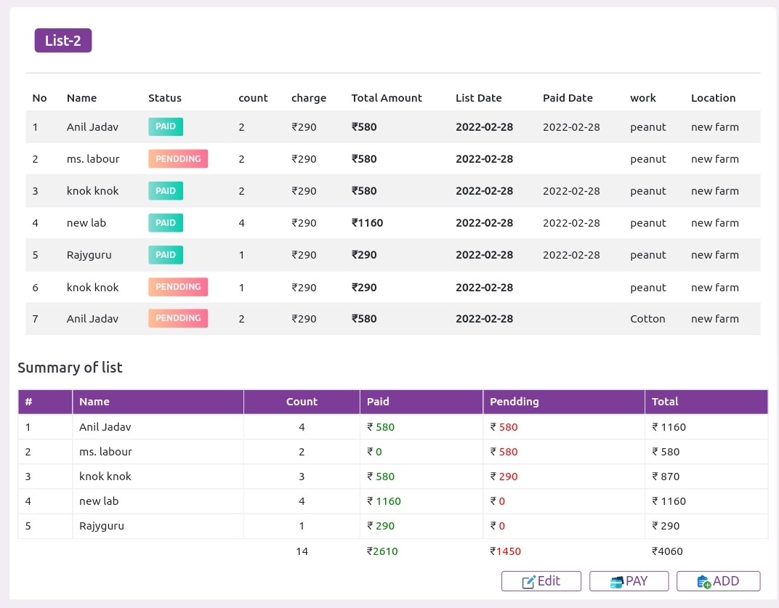
Summary Page
Delete List
Add List
Payment
View Summary
Shows Labours working days
Shows labour vise Statics
Shows total paid & unpaid amt
Shows paid date
Perform many operatins

Slide 29
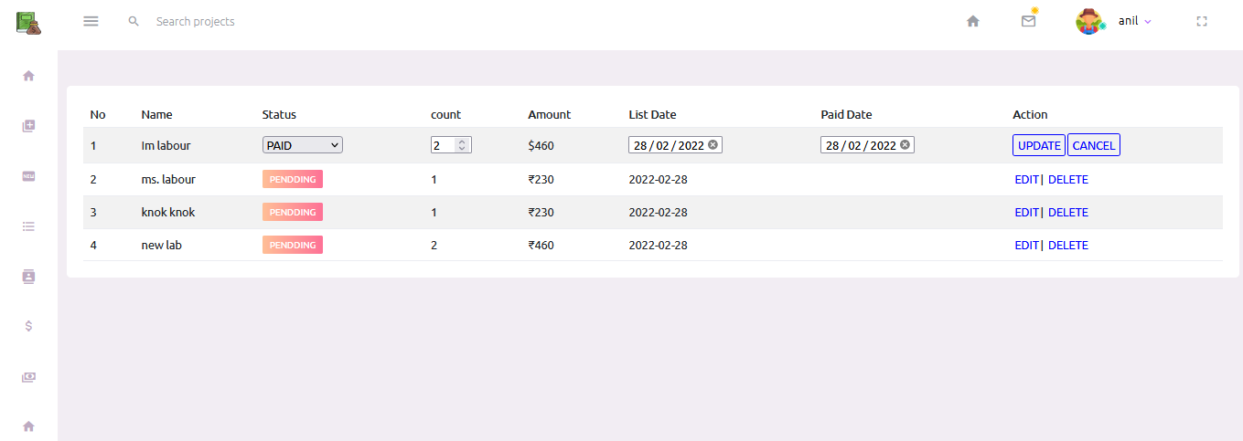
Edit or Update Page

Slide 30
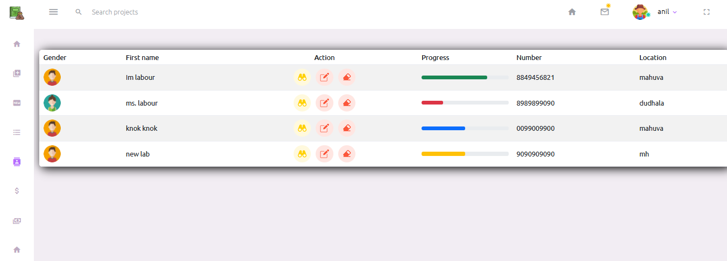
Labours Page
View Labours
Edit & Delete Labour
Progress bar

Slide 31
TESTING
3

Slide 32
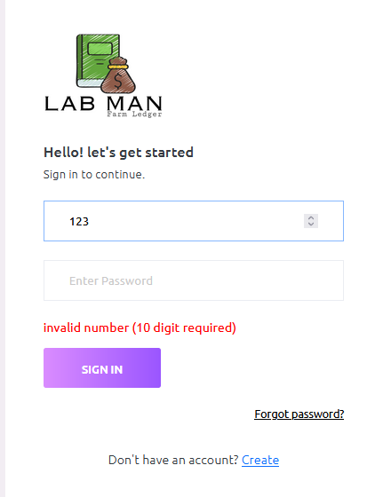
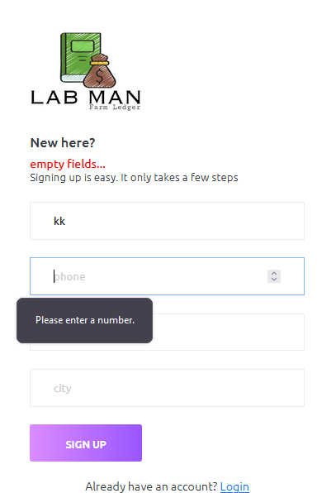
Validations
Client side and server side
All fields field
Length of number 10 digit
Password greater then 6 character

Slide 33
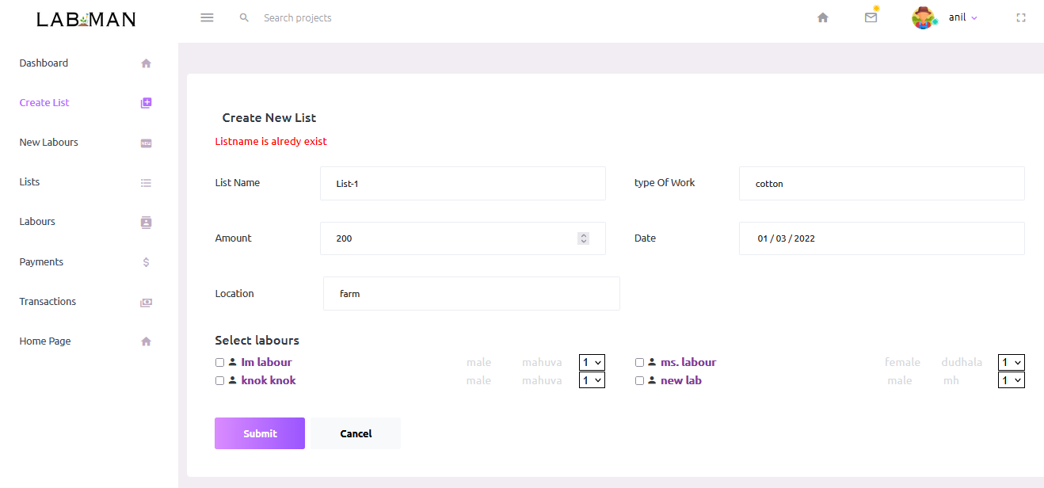
Validations
Check list name is already existing in database or not

Slide 34
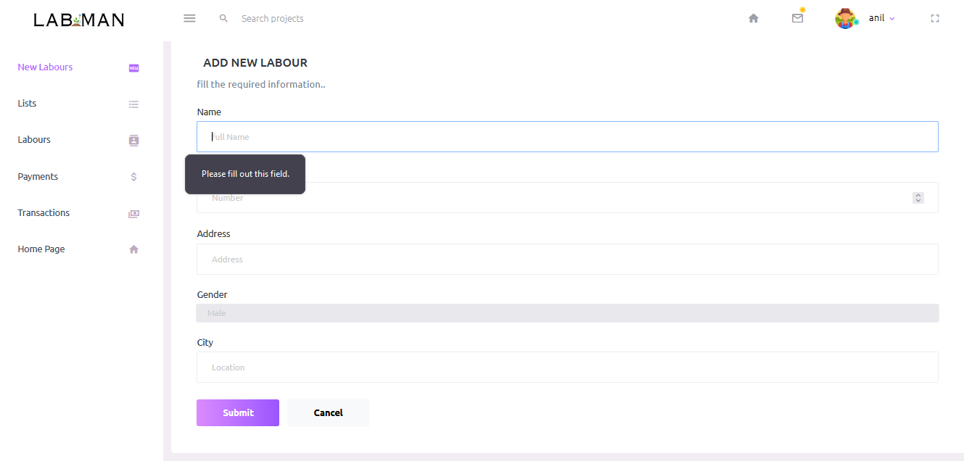
Validations
All field are required user can’t leave empty (also server side check)

Slide 35
Limitations
Now available in only English Language
Less knowledge of it
User Prefer Application
No sms and email api
Web limitations

Slide 36
Future Scope
Develope Android App for Provide Better User Experince
Add More Features
Improve Loading Speed and provide a faster web
Multiple Language Support
Pdf Report genarate
Email And Message Api

Slide 37
THANKS!
Do you have any questions?
www.niljadav.com
+91 7874492990
www.labman.xyz

Slide 38

Andoroid APP (beta version)
App is under development
Launching soon as possible

